Slide 1

MOMO API – Dynamic Journeys

Slide 2
DJS Overview
MOMO DJS enables service Providers expose their Products using MTN channels e.g USSD or MTN Apps.
Provider Journey defined in XML FILE using specified format/syntax.
MTN DJS system interacts with Provider system via Rest API with predefined format

Slide 3
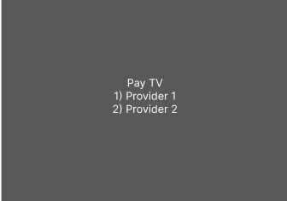
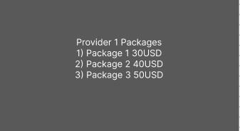
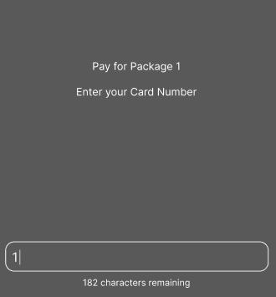
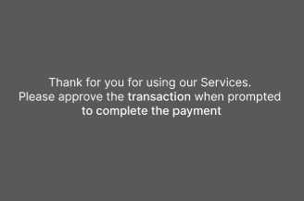
Dynamic Journey Syntax
Use Case | DJS Tag / Instruction Type
List Menu Items - Static | <options>
List Menu Items - Dynamic | <dynamicoptions>
Input Field | <question>
Make Call to Server | <dynamicarguments>
Make Decision | <matches>, <exists>, <switch>
End Journey | <response>, <responsematching>

Slide 4


Thank you
API GUY UGANDA
ugapiguy@gmail.com
https://www.youtube.com/@ApiGuyUganda

